Slide 1

Attendance Management System using Half-Face Recognition
Project Mentor : Ms. Mannat Doultani
Group Number : 4
Group Members :
Yogesh Tekwani(Group Leader)
Sagar Sidhwa
Somesh Tiwari

Slide 2
Content
Introduction to Project
Literature Survey
Lacuna in the existing System
Problem Definition
Block Diagram of the Project (Conceptual Architecture)
Modular Diagram of the Project (Also DFD, Use Case diagram / ER Diagram)
Hardware, Software, tools and the constraints
Methodology employed
Algorithms Implemented
Implementation Details (Flowchart, GUI Screenshots, Dataset Used)
Results Obtained (Screenshots)
Evaluation Measures
Conclusion
Future Scope
References
Review Sheet 1
Details of paper Published

Slide 3
Introduction to Project
Automatic face recognition technologies have made immense improvements in the changing world. The task of the proposed system is to capture the face of each student and to store it in the database for their attendance.
There is no need for the teacher to manually take attendance in the class because the system is provided with the image/Video by the teacher and through further processing steps the faces are being recognized and the attendance database is updated accordingly.
It helps in increasing the accuracy to ultimately achieve High-Precision Real-Time attendance to meet the need for Automatic classroom evaluation.

Slide 4
Literature Survey
K.Senthamil Selvi, P.Chitrakala, A.Antony Jenitha, “Face recognition based Attendance marking system” IJCSMC, Vol. 3, Issue. 2, February 2014, pg.337 – 342
Mr.C.S.Patil, Mr.R.R.Karhe, Mr.M.D.Jain, “Student Attendance Recording System Using Face Recognition with GSM Based” International Journal of Research in Advent Technology, Vol.2, No.8, August 2014 E-ISSN: 2321-9637
Mathana Gopala Krishnan, Balaji, Shyam Babu, “Implementation of Automated Attendance System using Face Recognition” International Journal of Scientific & Engineering Research, Volume 6, Issue 3, March-2015

Slide 5
Lacuna in the existing system
Real-Time Authentication is completely dependent on Manual process.
Inconsistency in data entry, room for errors, miskeying information.
Time consuming and costly to produce reports.
Lack of security.
No Transparency.

Slide 6
Problem Definition
This project aims to capture the photo or video of the students, convert it into frames, relate it with the database to ensure their presence or absence, mark attendance with time stamp for the particular student to maintain the record.

Slide 7
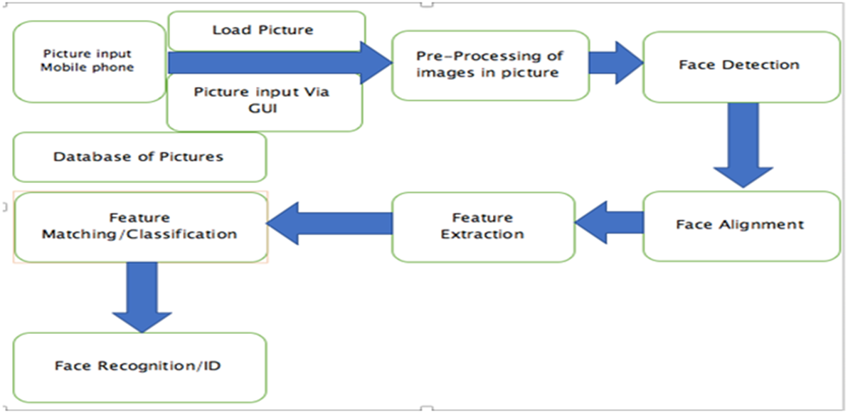
Block Diagram :

Slide 8
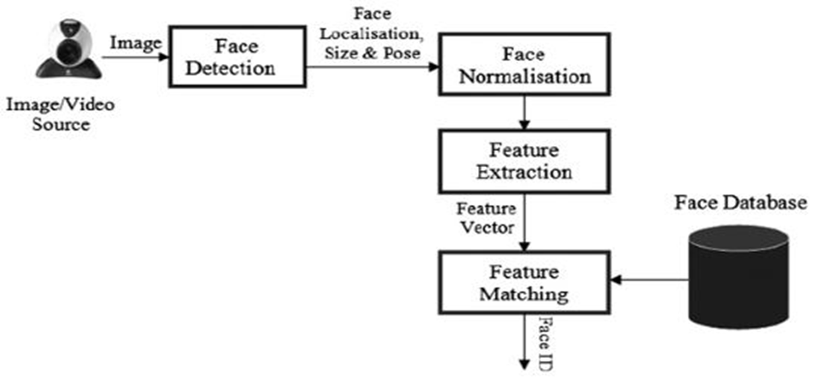
Modular Diagram :

Slide 9
Hardware, Software, Tools and constraint
Software Used:
Anaconda
Dlib
Visual Studio
Tools :
Cmake
VC++
Windows 10 SDK
OpenCV
Constraint:
Good Quality Camera.
Continuous Network Connectivity Required.
Faces should be properly visible to the Camera .
Processor requirement varies according to the size of the Database.
Camera Accessibility

Slide 10
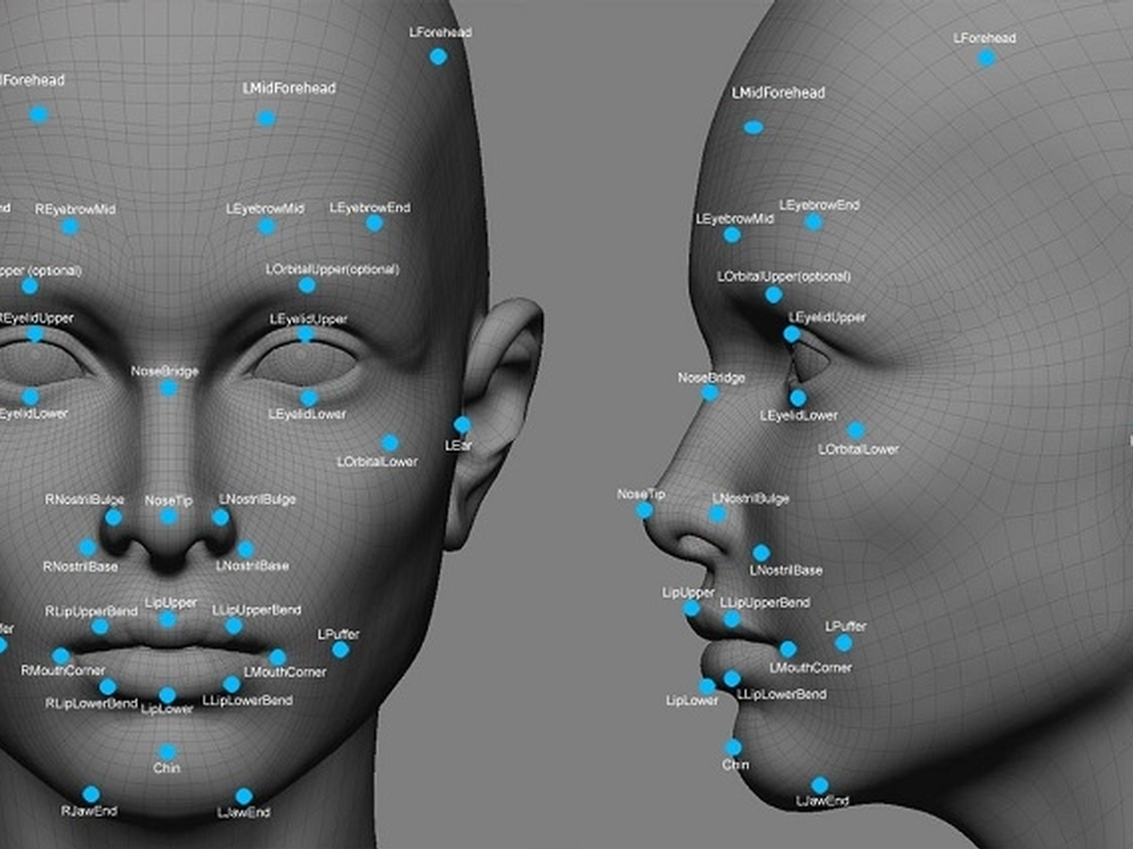
Methodology Employed
The proposed system though primarily based on the capturing points on faces.
The first being the extractions of some facial features of the known images.
The second is the extraction of facial features of the captured images.
Third is to comparing the known with the unknown.
Fourth is that if match found then Face Recognition is done.
Finally recording the attendance of the recognized images.
Notes:
f

Slide 11
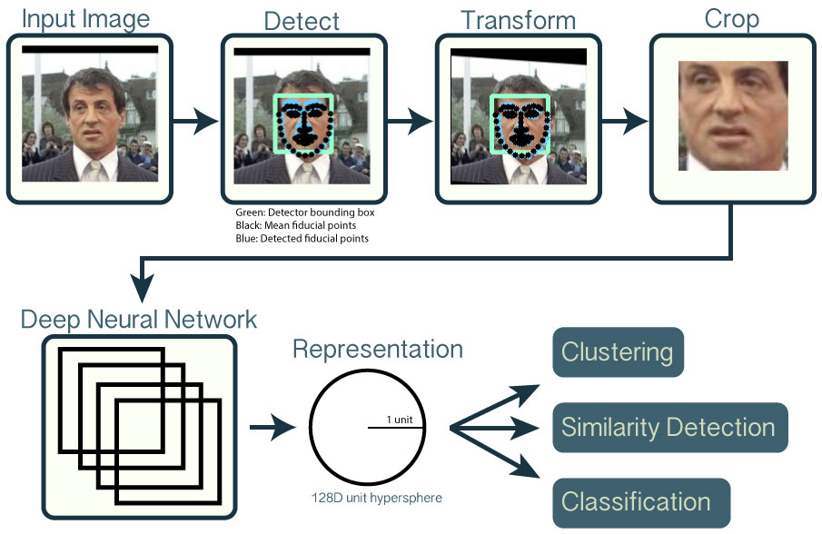
Algorithms Implemented
Face Recognition Algorithm :
OpenCV and Face Recognition is the most popular library for computer vision. It now provides bindings for Python.
OpenCV uses machine learning algorithms to search for faces within a picture.
Because faces are so complicated, there isn't one simple test that will tell you if it found a face or not.

Slide 12
Implementation Details
Steps For Implementation Of Face Recognition:
Finding all the Faces: The first step in our pipeline is face detection
Posing and Projecting Faces: we isolated the faces in our image.
Encoding Faces:Generating the Encodings for Each image in Database and Saving it for further Operations.
Encoding our Input face image: Generating Encoings for the input Image.
Match the Encodings:Comparing the Encodings of the known with respect to unknown.
Finding the person’s name from the encoding: Finally Recognized images are marked as present.

Slide 13
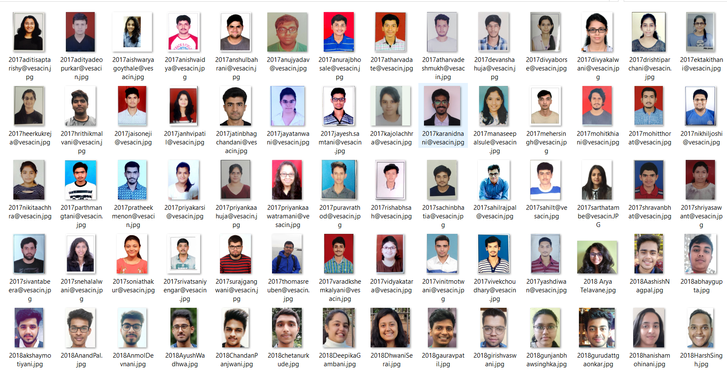
Images In Database(>150)

Slide 14
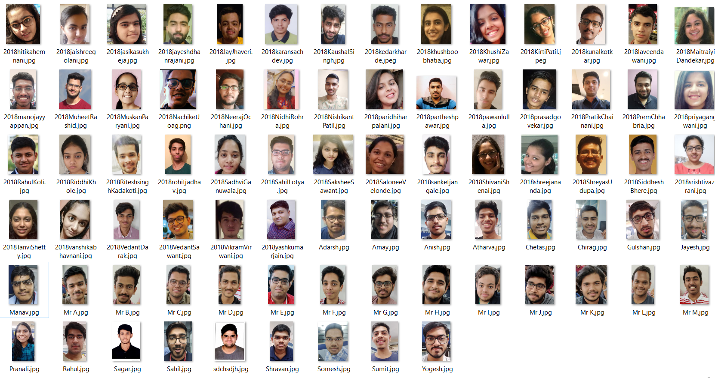
Images In Database

Slide 15
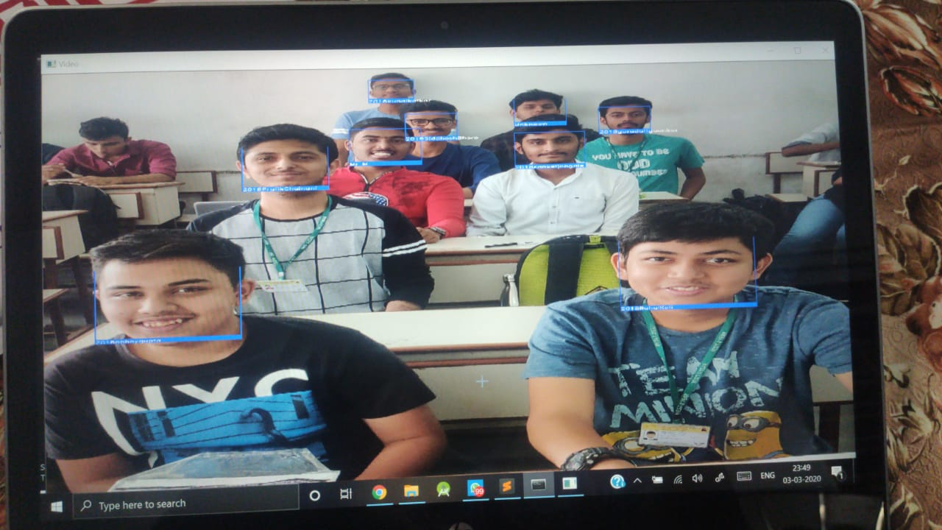
Results Obtained (Screenshots)

Slide 16
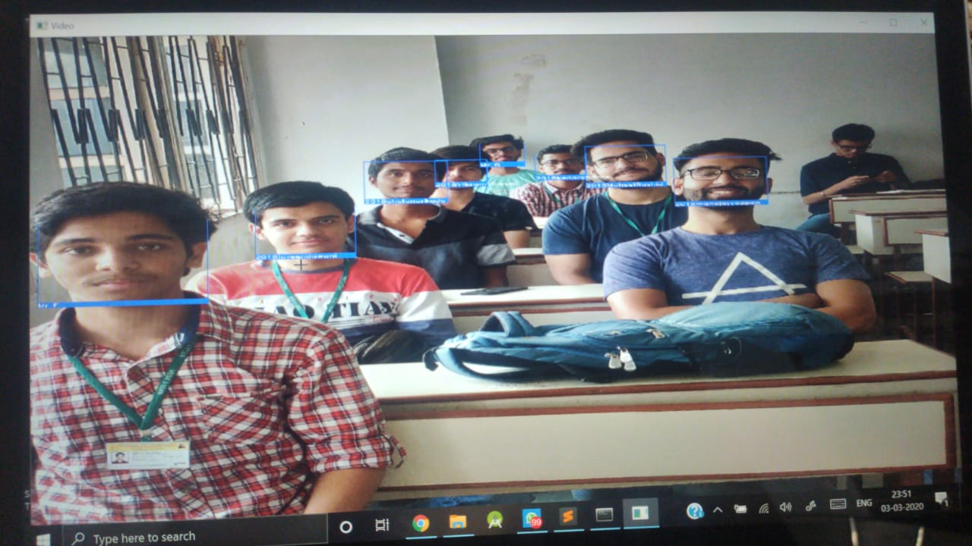
Results Obtained (Screenshots)

Slide 17
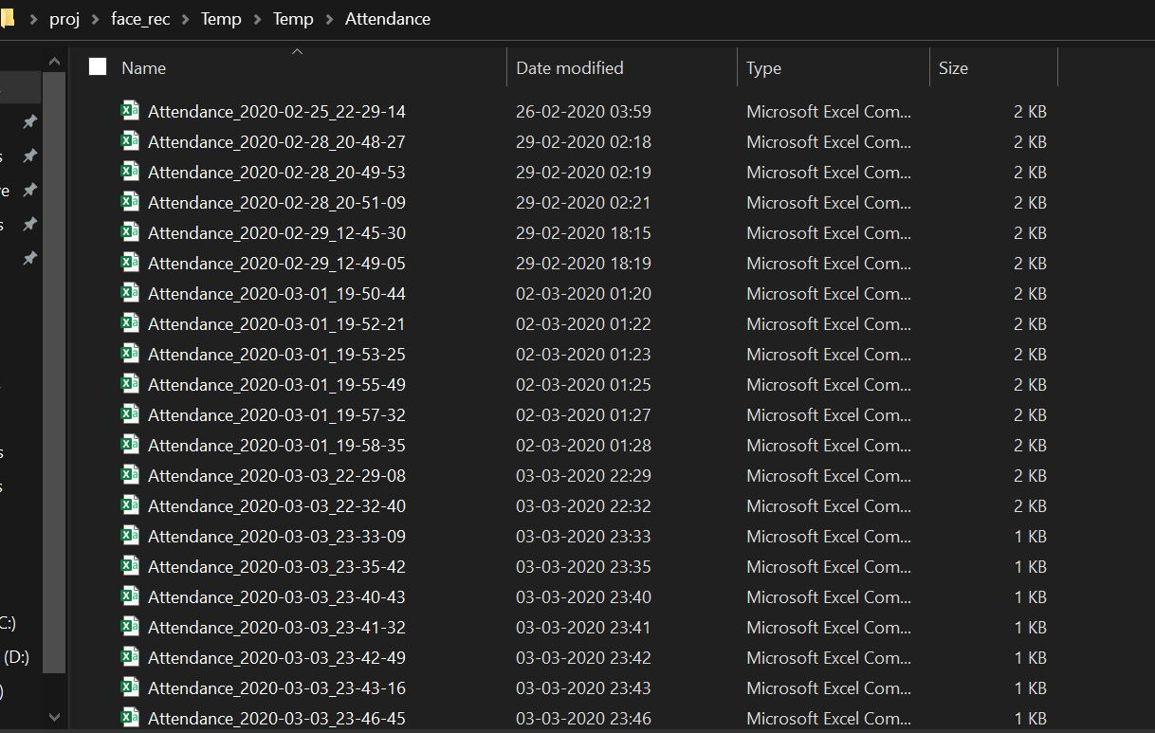
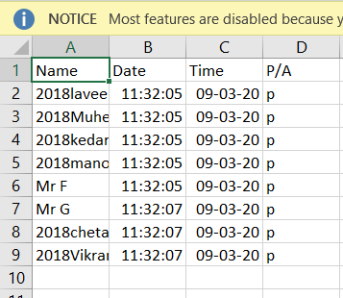
Results Obtained (Screenshots)

Slide 18
Evaluation Measures
Review 1
TOTAL IMAGES IN THE DATASET : 40
Output Accuracy :
7 out of 7 recognized. ( avg > 90% )
9 out of 9 recognized. (avg >90% )
Review 2
TOTAL IMAGES IN THE DATASET : 150
Output Accuracy :
9 out of 9 recognized. ( >90% )
8 out of 8 recognized. ( >90% )
Also, the current processing time has nearly decreased to half

Slide 19
Conclusion
Thus, our solution for Intelligent Attendance successfully minimizes Human-Interference, Enhances transparency and completely eliminates the Gaps of the current system.
The Automation helps in eliminating the Fraudulent entries and ultimately achieve the High-precision, Real-Time attendance to meet the need for Automatic and Reliable evaluation.

Slide 20
Future Scope
Currently, we have designed a system that detects the presence of a person by using Real-Time Face Recognition from a Real-Time Camera (eg: Photo).
Also, we are strategizing to detect and store the Unknown faces as well for further evaluations.
Since, the base model is in working condition, we have received many useful suggestions to build multiple UIs for Gyms, Classrooms, Playschools, Security Alarms, ATMs, Seminar Halls, CCTV Footage Scanners, etc.

Slide 21
References
K.Senthamil Selvi, P.Chitrakala, A.Antony Jenitha, “Face recognition based Attendance marking system” IJCSMC, Vol. 3, Issue. 2, February 2014, pg.337 – 342
Mr.C.S.Patil, Mr.R.R.Karhe, Mr.M.D.Jain, “Student Attendance Recording System Using Face Recognition with GSM Based” International Journal of Research in Advent Technology, Vol.2, No.8, August 2014 E-ISSN: 2321-9637
Mathana Gopala Krishnan, Balaji, Shyam Babu, “Implementation of Automated Attendance System using Face Recognition” International Journal of Scientific & Engineering Research, Volume 6, Issue 3, March-2015

Slide 22
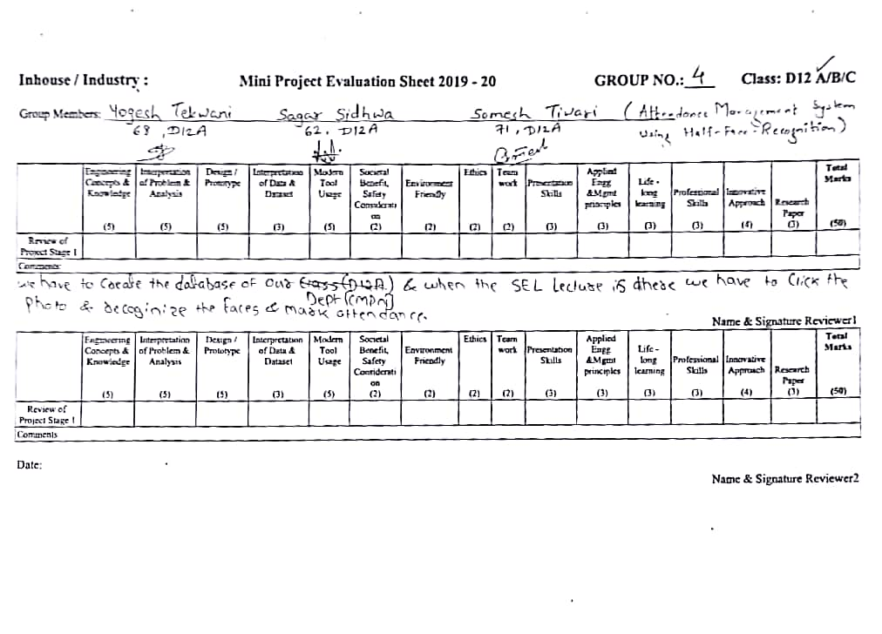
Review Sheet 1

Slide 23
Details of Paper Published
COMING SOON……...

